Slide 1
Document Object Model
Writing clean code

Slide 2
The Document Object Model (DOM)
Basis of HTML5 is “New features should be based on HTML, CSS, the DOM, and JavaScript…”
DOM provides common tree-like structure that all pages should follow
Computer Scientists love trees (the mathematical kind) because you can test them.

Slide 3
HTML is built on the DOM
z
Document
Root element
<html>
Element
<head>
Element
<body>
Element
<title>
Attribute
“href”
Element
<a>
Element
<h1>
Text
“my title”
Text
“my link”
Text
“my header”
Adapted from w3Schools.com

Slide 4
Three parts of a well-formed document
Doctype
Version of HTML that you will be using
Head
Metadata
Body
Displayable content

Slide 5
Doctype
HTML5
<!DOCTYPE html>
Previous versions dictated backwards compatibility
<!DOCTYPE HTML PUBLIC "-//W3C//DTD HTML 4.01//EN" "http://www.w3.org/TR/html4/strict.dtd">
<!DOCTYPE HTML PUBLIC "-//W3C//DTD HTML 4.01 Transitional//EN" "http://www.w3.org/TR/html4/loose.dtd">

Slide 6
Head
Additional information used by the browser
Meta data – language, title
Supporting files – JavaScript, Styling, Add-ons
Other than title, meta-data is not displayed

Slide 7
Body
Bulk of your page
Important to write well-formatted (tree-like) code.
Most of the content is displayed by the browser, but there may be some meta-data too

Slide 8
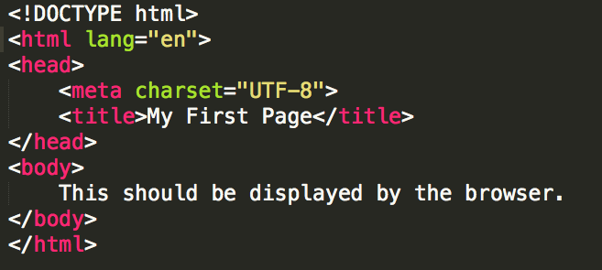
Example
Example: template.html

Slide 9
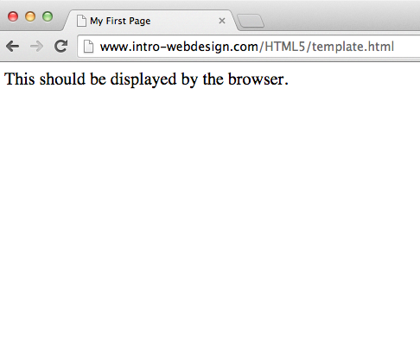

Slide 10
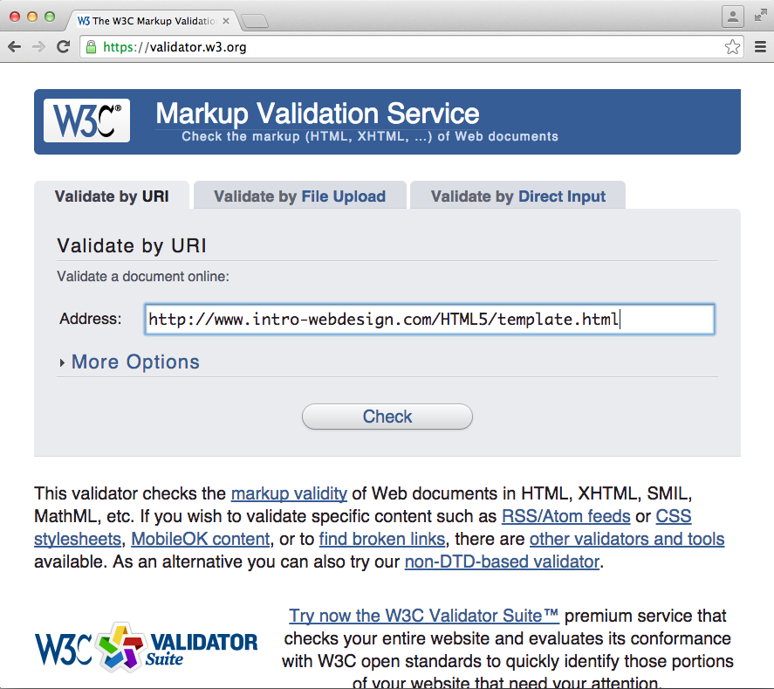
Validate the Code

Slide 11
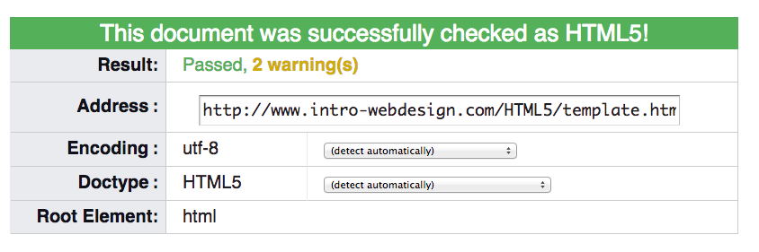
Success!!

Slide 12
Review
Well-formed pages use the DOM structure
Use beginning and end tags
Close inner tags before outer ones
Use valid attributes
Browsers will “fix” bad code, but not always well. Use a validator to check your code

Slide 13

Acknowledgements/Contributions
These slides are Copyright 2015- Colleen van Lent as part of http://www.intro-webdesign.com/ and made available under a Creative Commons Attribution 4.0 License. Please maintain this last slide in all copies of the document to comply with the attribution requirements of the license. If you make a change, feel free to add your name and organization to the list of contributors on this page as you republish the materials.
Initial Development: Colleen van Lent , University of Michigan School of Information

